Slide 1
Genomic Expression in Taenia solium
Miguel Perez

Slide 2
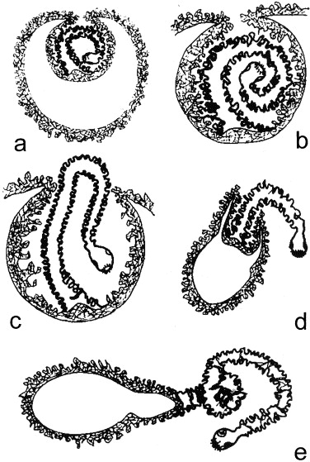
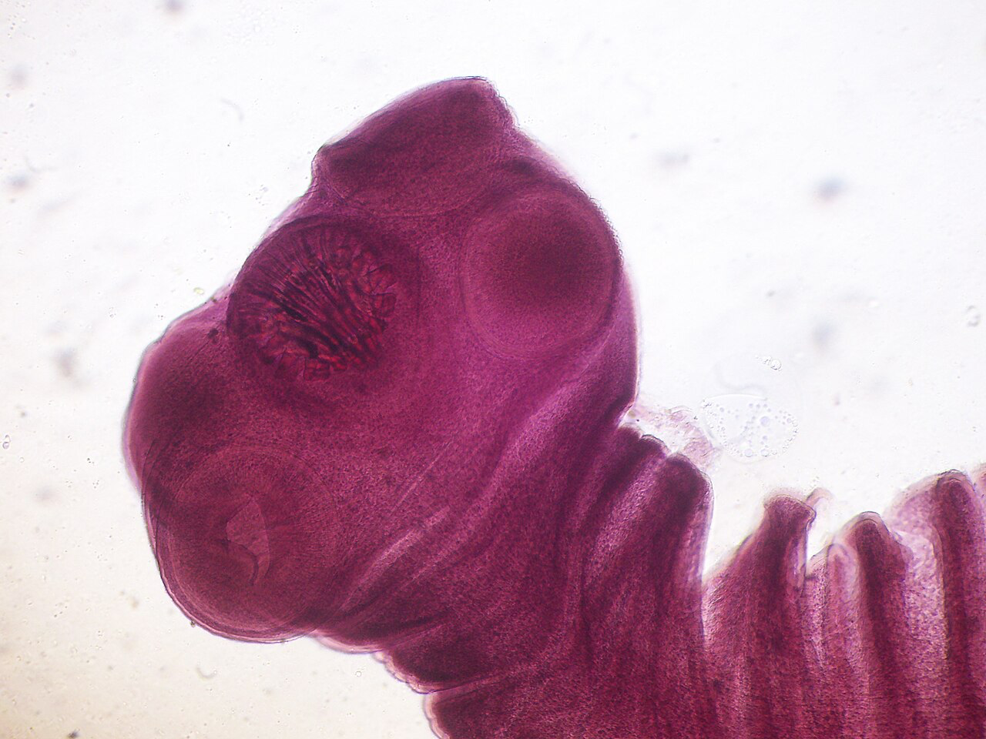
Taenia solium/Pork Tapeworm
Stage of infection of concern: Evagination
The outward eversion of the scolex/head from the cyst stage
Marks an important stage from dormancy to active adult development
Parasitic infection upon eating raw pork meat with T. solium cysts (in meat) or eggs (in feces)
Abdominal pain, nausea, neurocysticercosis

Slide 3

The main question:
How does gene expression differ in cyst development between pre-evagination and post-evagination?

Slide 4

The Methods | Primarily through Galaxy
DESeq2 - Takes all given conditions and sees if it is more represented in one condition or the other, gives statistical significance
Volcano Plot - shows statistical significance through plotting p-values among the downregulation and upregulation of genes
HeatMap2 - shows the degree of upregulation and downregulation in genes

Slide 5
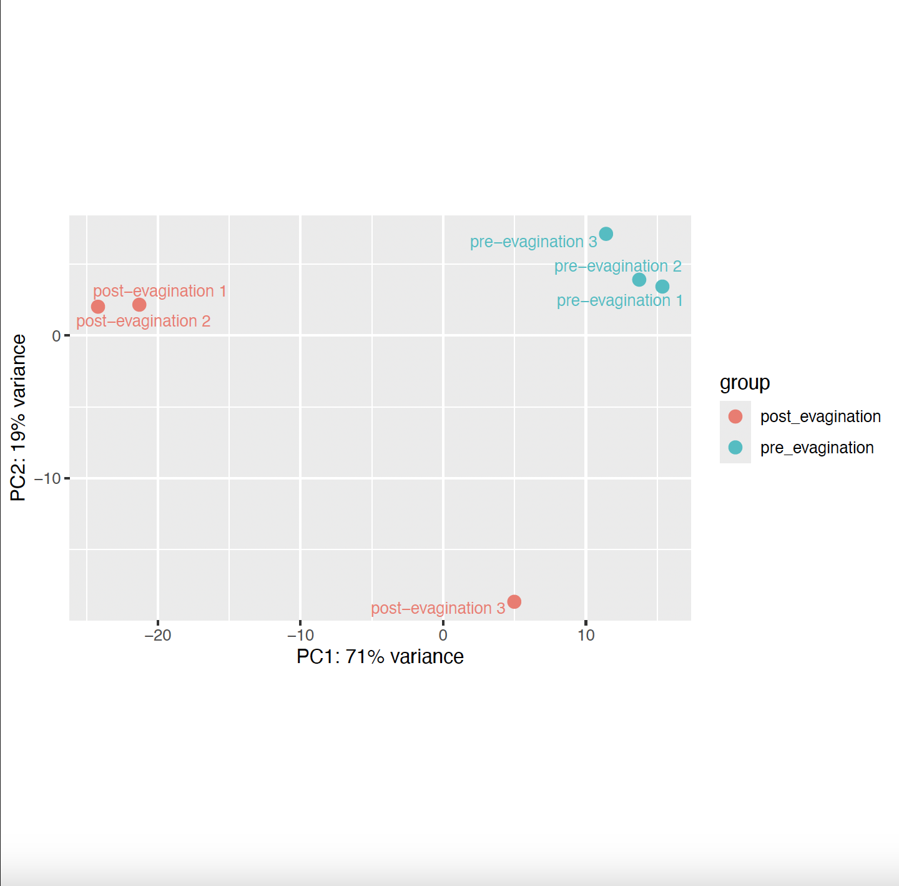
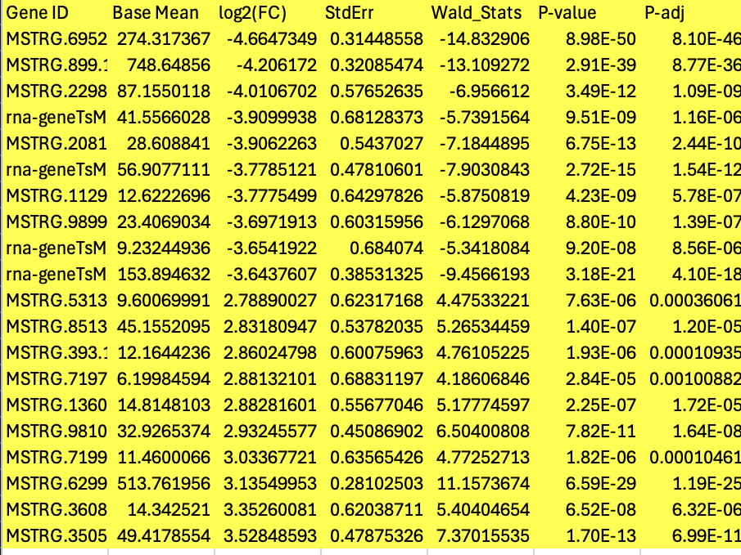
DESeq2 Plot and Results
Top 10 smallest and largest fold change, all statistically significant
P-adj < 0.05
Significantly different gene expression!
Observed differential expression between pre-evagination and post-evagination

Slide 6
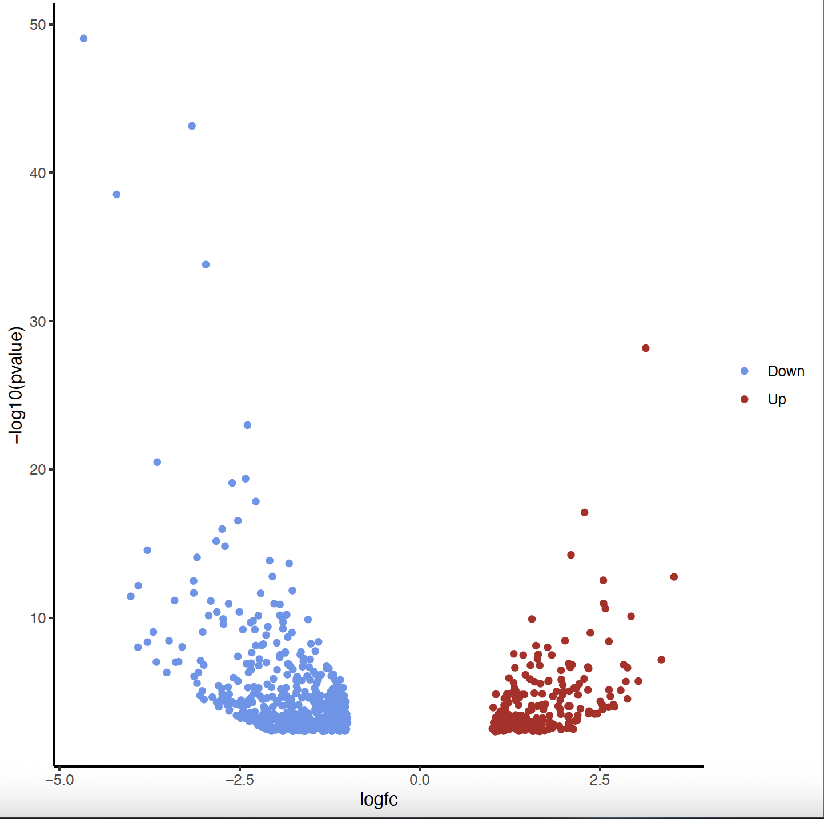
Volcano Plot
Down regulation is more populated, but also has more statistically significant values
Lesser FC value, less differential expression
Up regulation population is less, medially statistically significant compared to down regulation
Has greater FC value, more differential expression

Slide 7
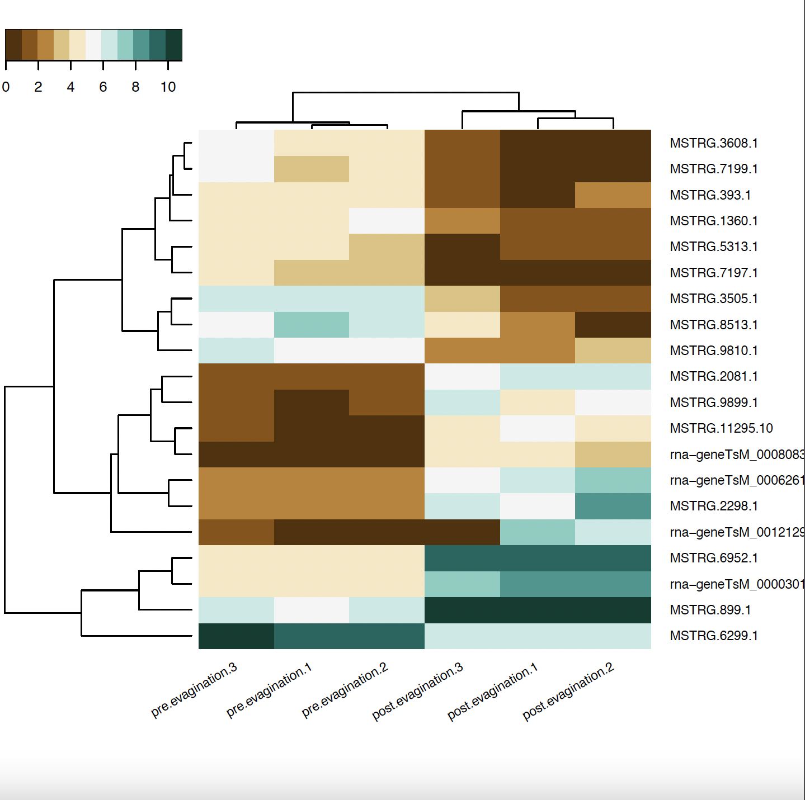
HeatMap2 plot
Down regulated gene: Mical/EHBP Rab binding function MSTRG.7197.1
Tubulation of cytoskeleton
Formation of flat proglottid segments, characteristic of cestodes
More heavily downregulated in post-evagination
Up regulated gene: MSTRG.6952.1 FibroNectin Type III
Only up regulated in post-evagination
Cell adhesion, migration, growth
Outward growth of scolex and subsequent proglottid body development.

Slide 8
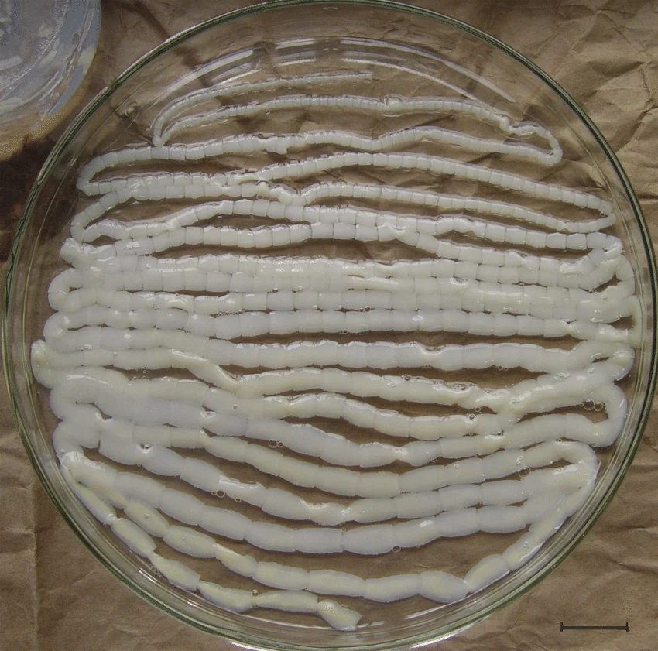
Conclusion:
Up regulation in regards to development post-evagination
Development of the proglottid segments!
Down regulation in regards to body shape development
No tubes! Flat body shape
Especially post-evagination!
There is significant differential gene expression between post-evagination and pre-evagination of T. solium!

Slide 9
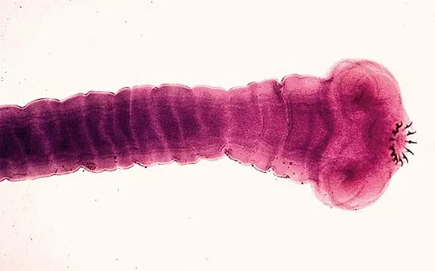
Thank You

